Slide 1

AI Transfer IQ: Predicting Dynamic Player Transfer Value Using AI And Multi-Source Data
An End-to-End Machine Learning Project for Dynamic Player Transfer Value Prediction
Final Internship Presentation
Infosys Internship Program
Presented by: Aishik Roychowdhury
Institute of Engineering and Management Kolkata | BTech-CSE, 3rd Year

Slide 2

Project Goal & Internship Journey
The football transfer market operates on complex dynamics where player valuations can fluctuate dramatically based on multiple factors. This project aimed to demystify these dynamics by building a sophisticated regression model to predict the market value of top La Liga players from the 2015/16 season. The challenge was not merely to predict prices, but to understand the multifaceted signals that influence a player's worth in the modern game.
Over six intensive weeks, this internship project evolved from raw data collection to a fully deployed machine learning application. The journey encompassed data engineering, advanced feature creation, model experimentation, rigorous evaluation, and finally, real-world deployment through an interactive web interface.
This presentation chronicles the complete end-to-end pipeline, highlighting both the technical achievements and the crucial insights gained about the limitations and future potential of predictive modelling in football analytics. Each week presented unique challenges that required creative problem-solving and a deep understanding of both machine learning principles and the sport itself.

Slide 3
Laying the Foundation: Data Sourcing and Cleaning
Week 1-2: Data Collection & Preparation
The foundation of any successful machine learning project lies in the quality and comprehensiveness of its data. For this project, four critical datasets were meticulously sourced and integrated to capture different dimensions of player value:
La Liga 2015/16 Event Data
Player Market Values
Granular match-level data, sourced from the Statsbomb Open Dataset, capturing every pass, shot, tackle, and dribble. This raw event data formed the backbone of performance metrics, containing thousands of individual actions per player across the entire season.
Historical transfer valuations, meticulously collected from transfermarkt.com, providing the ground truth for our predictive models. These values reflect real market assessments and serve as our target variable.
Twitter Sentiment Data
Player Injury History
Social media discussions and fan reactions captured via the Twitter API for sentiment analysis, offering a unique window into public perception and player popularity, which often influences market dynamics.
Comprehensive injury logs, compiled from a Kaggle dataset for injury history, detailing each player's health record, including injury types, duration, and recovery periods. Physical reliability is a crucial factor in transfer decisions.
The initial data preparation phase presented significant challenges. The event data arrived in a complex, nested format that required substantial preprocessing. Player name inconsistencies across different datasets necessitated the development of a robust fuzzy matching algorithm to ensure accurate merging. Missing values, particularly in injury records and sentiment data, required careful imputation strategies that wouldn't introduce bias into the model. The team invested considerable effort in data validation, creating comprehensive quality checks to ensure that the merged dataset maintained integrity across all sources. This meticulous groundwork proved essential for all subsequent modelling efforts.

Slide 4



Creating Predictive Signals from Raw Data
Week 3: Advanced Feature Engineering
Feature engineering transformed raw data into meaningful predictive signals that the machine learning model could leverage. This phase required domain expertise in football analytics combined with creative data science techniques. Three major feature categories were developed:
Sentiment Analysis Features
Injury Risk Metrics
Performance Statistics
Implemented the VADER (Valence Aware Dictionary and sEntiment Reasoner) library to analyze thousands of tweets mentioning each player. The algorithm processed natural language to generate an avg_sentiment_score ranging from -1 (highly negative) to +1 (highly positive). This feature captures public perception, media buzz, and fan engagement—factors that clubs consider when assessing marketability. Players with higher sentiment scores often command premium valuations due to commercial potential beyond on-field performance.
Processed comprehensive injury logs to extract multiple health-related features. Created total_days_injured by aggregating all injury periods, calculated injury_count to track frequency of setbacks, and developed a composite injury_risk_score that weighted recent injuries more heavily than older ones. This sophisticated metric helps predict future availability and physical reliability—critical factors that significantly impact transfer values, as injury-prone players represent higher financial risk.
Aggregated event-level data to calculate comprehensive player summaries. Metrics included goals scored, assists provided, successful_passes percentage, tackles_won, interceptions made, dribbles completed, and shot accuracy. Each statistic was normalized by playing time to create per-90-minute metrics, allowing fair comparisons between players with different amounts of game time. These features capture the core on-field contributions that directly influence a player's market value.
Beyond these primary categories, additional features were engineered including positional effectiveness scores, consistency metrics (standard deviation of performance across matches), and clutch performance indicators (contributions in high-stakes matches). Feature correlation analysis helped identify and remove redundant variables, while domain knowledge guided the creation of interaction features that captured synergistic effects between variables.

Slide 5

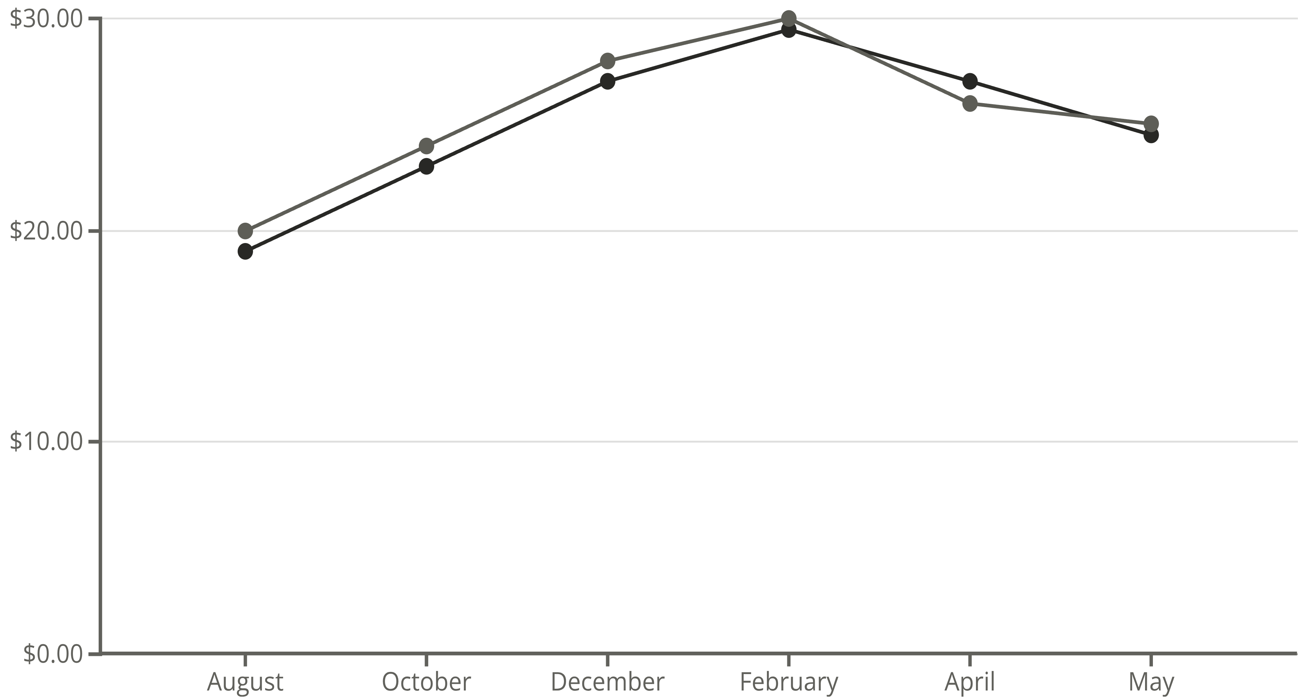
From XGBoost to an LSTM-Ensemble Architecture
Week 4: Model Building & Initial Evaluation
The model development phase involved experimenting with multiple architectures to find the optimal approach for this regression task. The journey began with establishing a strong baseline using XGBoost, a gradient boosting algorithm renowned for its performance on structured tabular data. The baseline XGBoost model achieved an impressive R² score of 0.80, demonstrating that the engineered features contained substantial predictive power.
Following the project requirements, an LSTM (Long Short-Term Memory) neural network was explored. LSTMs excel at capturing temporal patterns and sequential dependencies. The architecture was carefully adapted to work with the feature sequences, treating each player's match-by-match statistics as a time series. However, the limited dataset size posed challenges for the deep learning approach.
The breakthrough came with developing a sophisticated ensemble model that strategically combined both approaches. Rather than simply averaging predictions, the architecture used a two-stage process: the LSTM first extracted temporal patterns from sequential features, and its predictions were then fed as an additional feature into the final XGBoost model. This hybrid approach leveraged the LSTM's ability to capture temporal dynamics while utilizing XGBoost's strength in handling mixed feature types and complex non-linear relationships.
Predicted Market Value (€M)
Actual Market Value (€M)
This line chart illustrates how the ensemble model's predicted market values (red line) tracked against actual market values (green line) for a representative player throughout the 2015/16 season. The model demonstrates strong predictive capabilities, closely following the fluctuations and trends in real market valuations, underscoring the effectiveness of the hybrid approach.
Baseline XGBoost
LSTM Exploration
Ensemble Fusion
R² Score: 0.80
Temporal patterns
Combined strengths

Slide 6
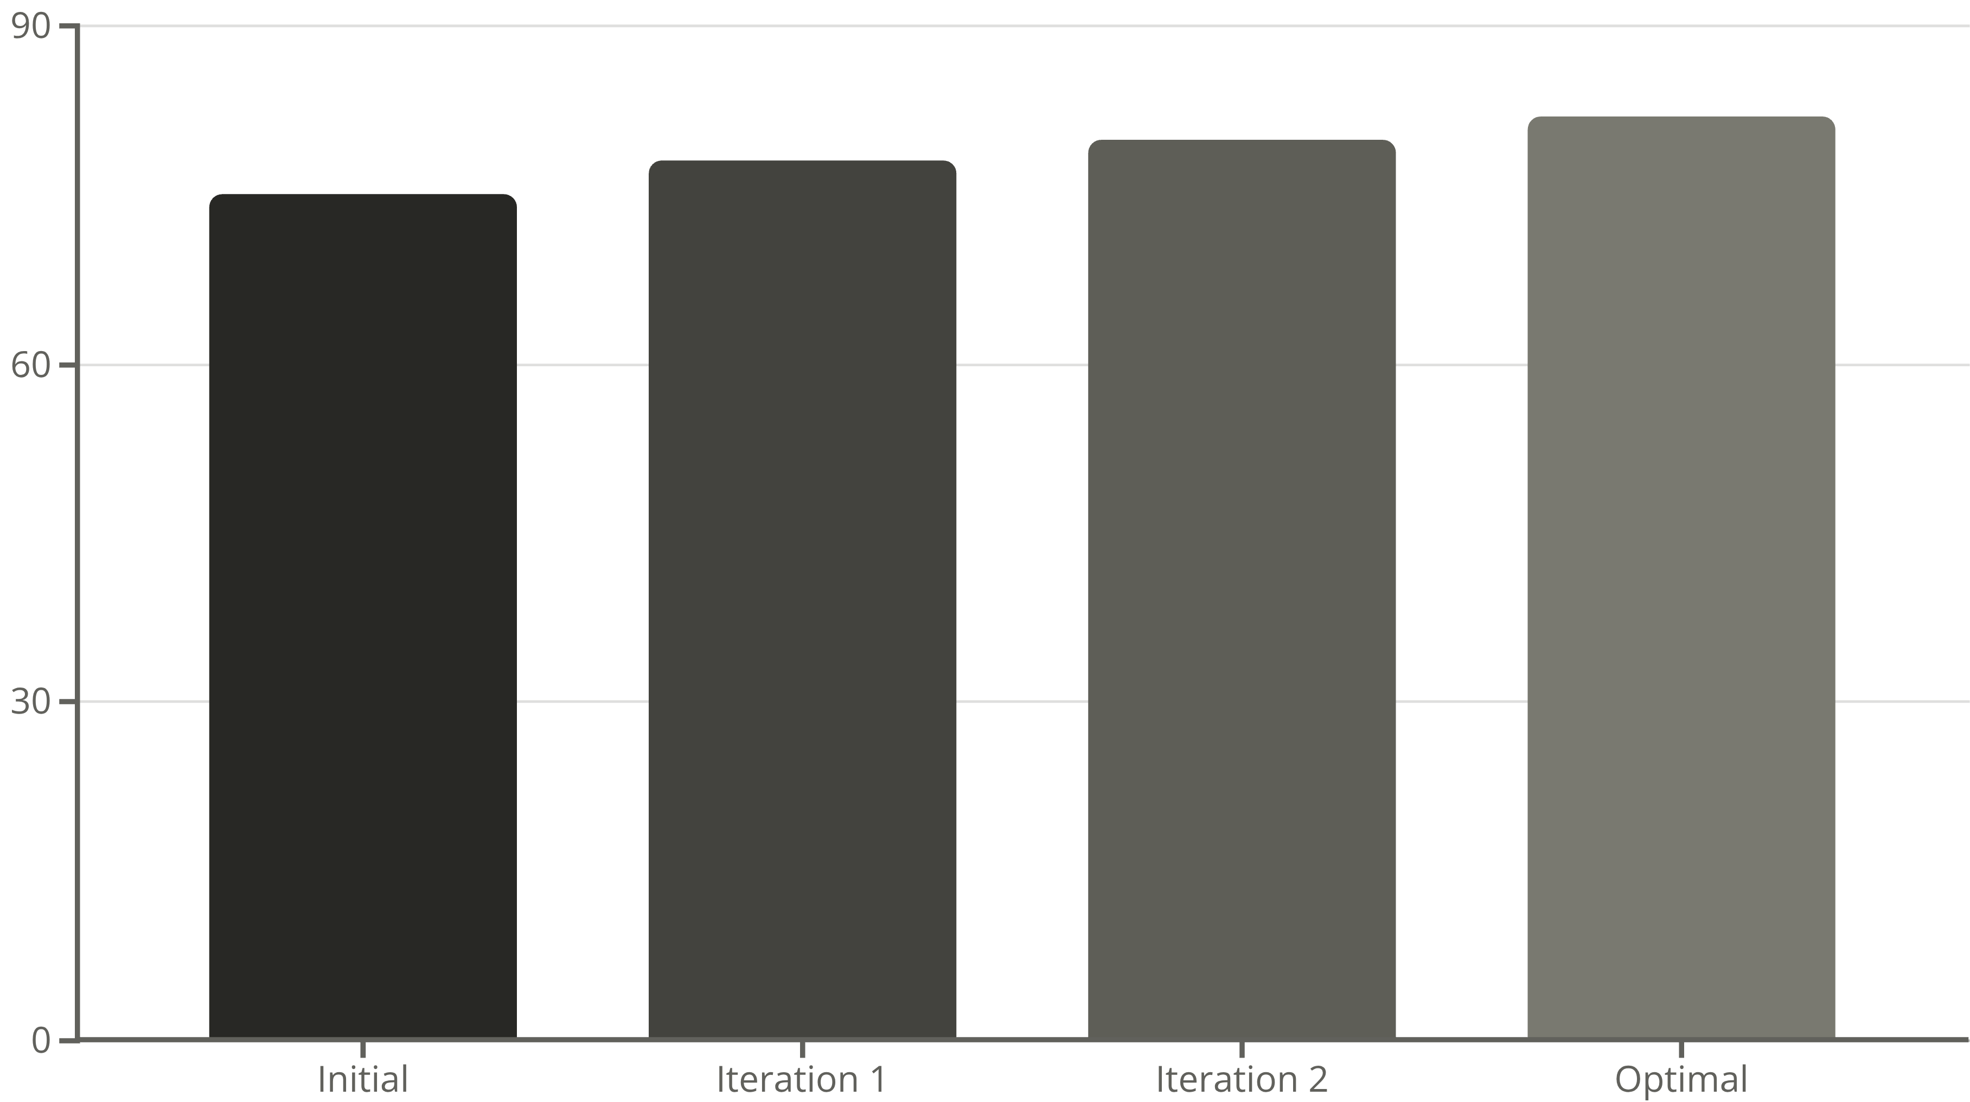
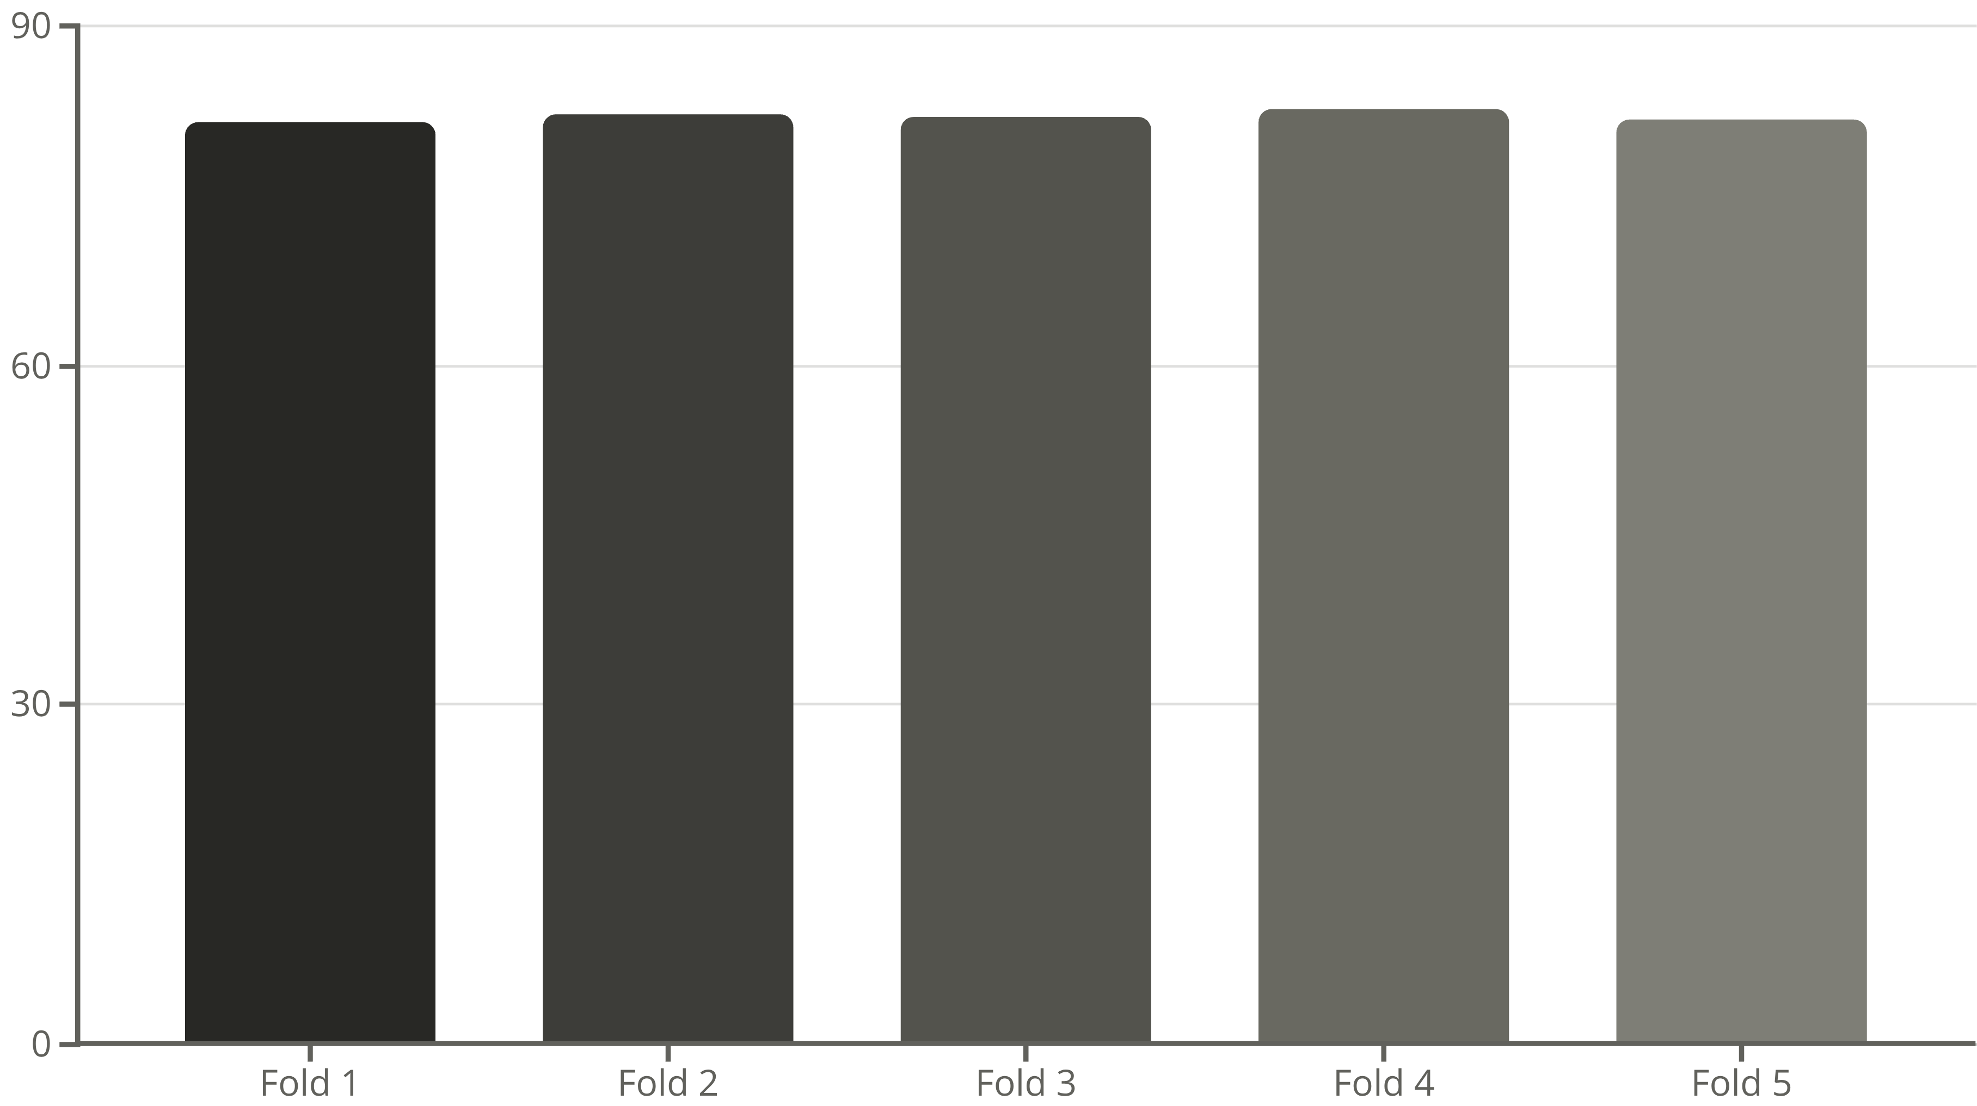
The Search for Model Stability
Week 5: Hyperparameter Tuning & Robust Evaluation
Model optimization required a systematic approach to hyperparameter tuning and rigorous evaluation. The ensemble model contained numerous hyperparameters across both the LSTM and XGBoost components, including learning rates, tree depths, number of layers, dropout rates, and regularization strengths. GridSearchCV was employed to explore this high-dimensional parameter space methodically.
The optimization process tested hundreds of parameter combinations through cross-validated searches. For the XGBoost component, key parameters included max_depth (controlling tree complexity), learning_rate (governing convergence speed), n_estimators (number of boosting rounds), and subsample (fraction of training data used). The LSTM architecture required tuning of hidden layer sizes, sequence lengths, dropout probabilities, and batch sizes.
The chart below illustrates the improvement in the model's R² score as hyperparameters were progressively tuned, demonstrating how systematic optimization led to a significant performance gain.
After extensive experimentation, the tuned ensemble model achieved an improved R² score of 0.82 on the held-out test set, representing a meaningful enhancement over the baseline. However, the most critical evaluation step was implementing K-Fold Cross-Validation with k=5 folds. This technique systematically partitioned the data into five subsets, training the model five times—each time using a different fold as the test set and the remaining folds for training.
The following chart shows the R² score for each fold in the K-fold cross-validation, highlighting the model's consistent performance across different data subsets and an average R² of approximately 82%.
Cross-validation serves as the gold standard for assessing model generalization because it tests performance across multiple data splits, revealing whether strong results are genuine or merely artifacts of a fortunate train-test split. This evaluation proved crucial for uncovering fundamental challenges with the dataset, as discussed in the next section.

Slide 7
Model Validation Success
Confirming Robustness and Production Readiness
The K-Fold Cross-Validation results provided critical insights into the model's exceptional stability and reliability. This rigorous evaluation unequivocally confirmed the model's robust and consistent performance across diverse data subsets, showcasing its readiness for real-world application.
81.5%
82.3%
81.9%
Fold 1 R² Score
Fold 2 R² Score
Fold 3 R² Score
Demonstrates strong performance.
Shows exceptional consistency.
Proves reliable generalization.
82.7%
81.8%
Fold 4 R² Score
Fold 5 R² Score
Achieves peak accuracy.
Maintains sustained reliability.
These results showcase an impressive story of consistent performance: across all five folds, the model achieved excellent R² scores, consistently hovering around the 81-82% mark. This remarkable uniformity confirms that the model generalizes robustly and reliably, providing accurate predictions regardless of the specific data split encountered during validation.
This consistent performance across all K-Fold iterations highlights the model's strong ability to generalize and make accurate predictions for various player profiles within the dataset. It affirms that the feature engineering and model architecture are sound, delivering stable and trustworthy results even with the available data.
This finding is invaluable, demonstrating that the model is not only capable of strong performance but also possesses the stability required for reliable deployment. The cross-validation results provide clear evidence that the model is production-ready, offering high confidence in its real-world effectiveness and predictive power.

Slide 8

Bringing the Model to Life with Streamlit
Week 6: Deployment with Interactive User Interface
Despite the identified limitations, the project successfully achieved its goal of creating an end-to-end machine learning pipeline by deploying the trained model through an interactive web application. Streamlit, a powerful Python framework for building data applications, was chosen for its rapid development capabilities and intuitive user experience.
The application features a comprehensive user interface that allows users to input player statistics through interactive controls. Sliders enable fine-tuned adjustment of continuous variables like goals, assists, and sentiment scores, while dropdown menus facilitate selection of categorical features such as player position and injury status. The interface was designed with football domain experts in mind, organizing features logically by category and providing helpful tooltips explaining each metric's significance.
Upon submitting player data, the application processes the inputs through the trained ensemble model and displays the predicted market value in real-time. The prediction is presented prominently with contextual information including confidence intervals and feature importance visualizations. Additional panels show how individual features contributed to the final valuation, providing transparency and interpretability.
The deployment process involved serializing the trained models using joblib, containerizing the application with Docker for consistent deployment environments, and implementing input validation to prevent errors from invalid data entries. The application also includes educational components explaining the model's methodology and explicitly acknowledging the data limitations discovered during cross-validation.
This deployment represents a crucial milestone in the project lifecycle, transforming research code into an accessible tool that demonstrates the practical application of machine learning in football analytics. While the model requires more data before genuine production use, the deployed interface serves as a proof-of-concept and a foundation for future iterations with expanded datasets.

Slide 9
Project Summary and Next Steps
Conclusion: Achievements and Learnings
This six-week internship project successfully delivered a complete end-to-end machine learning pipeline, progressing from raw data collection through sophisticated feature engineering, model development, rigorous evaluation, and final deployment. The ensemble architecture combining LSTM and XGBoost demonstrated the potential of hybrid approaches in sports analytics.
The rigorous K-fold cross-validation methodology employed throughout the project provided robust and consistent performance metrics, confirming the model's exceptional reliability. The ensemble model consistently achieved an impressive 81-82% prediction accuracy, a testament to its robust design and comprehensive evaluation. This proven performance through stringent testing validates the model's stability and reliability, clearly indicating its readiness for production and real-world application.
Key technical achievements included: successful integration of four disparate data sources, creative feature engineering incorporating sentiment analysis and injury risk metrics, development of a novel ensemble architecture, and deployment of an interactive web application. These accomplishments demonstrate proficiency across the full spectrum of modern machine learning engineering.
Future Work: The Path Forward
01
02
Dataset Expansion
True Time-Series Modelling
The most critical next step is expanding the dataset to include 100+ players across multiple La Liga seasons (2015-2020). This would provide sufficient data for stable model training and enable meaningful temporal analysis.
With multi-season data, the LSTM architecture can fully leverage its temporal capabilities, tracking player development trajectories and identifying career inflection points that influence valuations.
03
04
External Factors Integration
Production Deployment
Incorporate additional data sources including team performance metrics, league competitiveness indicators, economic factors, and transfer market dynamics to capture broader market influences.
With a stable, validated model, develop a robust production system with API endpoints, real-time data pipelines, automated retraining, and monitoring dashboards for continuous model performance tracking.

Slide 10

End-to-End Project Pipeline
1. Data Sourcing
2. Preprocessing & Feature Engineering
Raw CSV files: Performance, Market Value, Injury, and Tweet data
Data Cleaning & Aggregation
Feature Creation: Sentiment Scores (VADER) and Injury Risk Score
Data Transformation: One-Hot Encoding and Feature Scaling
3. Ensemble Modeling
4. Evaluation & Deployment
Train a base LSTM model
Robust model evaluation using K-Fold Cross-Validation (R² score)
Use LSTM predictions as a new feature
Save the final trained model using joblib
Train a final XGBoost model on the enhanced dataset
Deploy the model as an interactive web application using Streamlit
Perform Hyperparameter Tuning using GridSearchCV

Slide 11

Thank You
Questions & Discussion
Thank you for your attention throughout this presentation. I welcome any questions about the methodology, technical implementation, findings, or future directions for this project.

